Slide 2
MISSION
Insert your mission here.
VISION
Insert your vision here.

Slide 3
Mobilize Dollars
Uniting donors, volunteers, advocates,
community organizations and governments, United Way
invests in services to meet community needs.
Organize & Connect
Funded programs provide increased access to health, education, financial stability and basic needs programs to people, often employed, but unable to make ends meet. This population is referred to as ALICE. Asset-Limited, Income-Constrained, Employed.
Improve Lives
United Way funded programs lead to successful children, thriving families and long-term solutions for those
unable to break the cycle of poverty on their own.

Slide 4
HOW UNITED WAY
WORKS
Mobilize Dollars
Mobilize Dollars
Uniting donors, volunteers, advocates,
community organizations and governments, United Way
invests in services to meet community needs.
NO ONE PERSON OR ORGANIZATION CAN DO IT ALONE.
UNITED WAY MAKES THE MOST OF YOUR INVESTMENT.
Organize & Connect
Organize & Connect
Funded programs provide increased access to health, education, financial stability and basic needs programs to people, often employed, but unable to make ends meet. This population is referred to as ALICE. Asset-Limited, Income-Constrained, Employed.
Improve Lives
Improve Lives
United Way funded programs lead to successful children, thriving families and long-term solutions for those
unable to break the cycle of poverty on their own.
Notes:
Update the text to fit your LUW. Feel free to add your own photo.

Slide 5
Alleviating Hunger
Reducing Homelessness
Encouraging Youth
Supporting Education
Improving Communities
Impact Area 1
Impact Area 2
Impact Area 3
Publix Focus Areas
Notes:
Insert your focus areas and how many partner agencies you have in that area. Feel free to adjust as needed if you have more than 3 or internal programs.

Slide 7
List Internal Programs and/or show logos

Slide 8
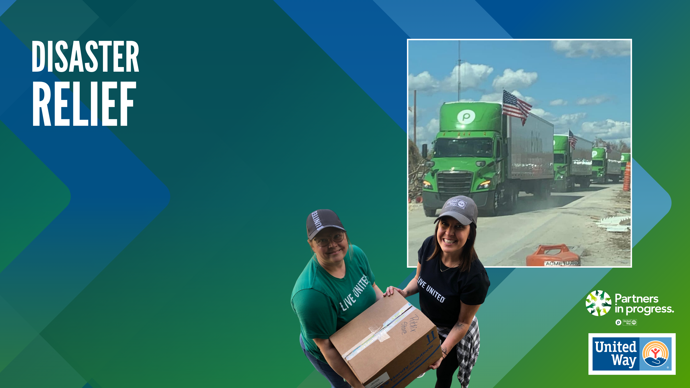
When disaster strikes, Publix partners with United Way Worldwide, state associations, and local United Ways to mobilize resources to support impacted employees and quickly reopen stores to serve the affected community.

Slide 9
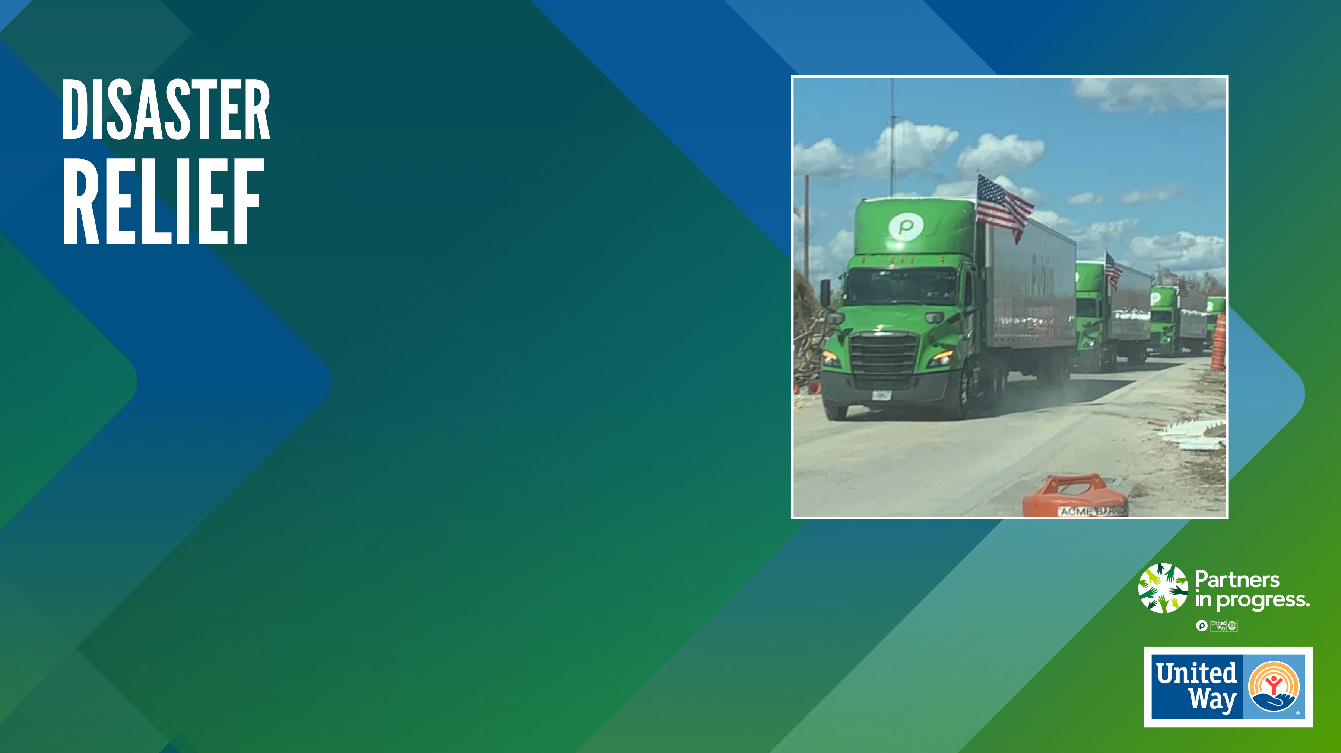
When disaster strikes, Publix partners with United Way Worldwide, state associations, and local United Ways to mobilize resources to support impacted employees and quickly reopen stores to serve the affected community.

Slide 11
YOUR DOLLARS AT WORK
Donor dollars Invested in health, education, financial stability and basic needs services last fiscal year.
Community Impact Number or Statistic unique to your United Way.
XX,XXX
$XM
XXX,XXX
XXX
XXX%
Residents served through United Way funded programs from July 2023 to June 2024.
Funded services at XX partner agencies serving local residents
Percentage of funds that stay in our community.

Slide 12
$1 A WEEK
What $1/week could provide at your United Way over the course of a year.
$3 A WEEK
What $3/week could provide at your United Way over the course of a year.
$5 A WEEK
What $5/week could provide at your United Way over the course of a year.
$10 A WEEK
What $10/week could provide at your United Way over the course of a year.
$20 A WEEK*
What $20/week could provide at your United Way over the course of a year.
*Giving at this level enrolls you into our Leadership Giving Association

Slide 13
Add your affinity group logos or list here.
Add list of volunteer opportunities here.
Your contact information is crucial to our connection!

Slide 14
Add your affinity group logos or list here.
Add list of volunteer opportunities here.
Your contact information is crucial to our connection!

